Slide 1
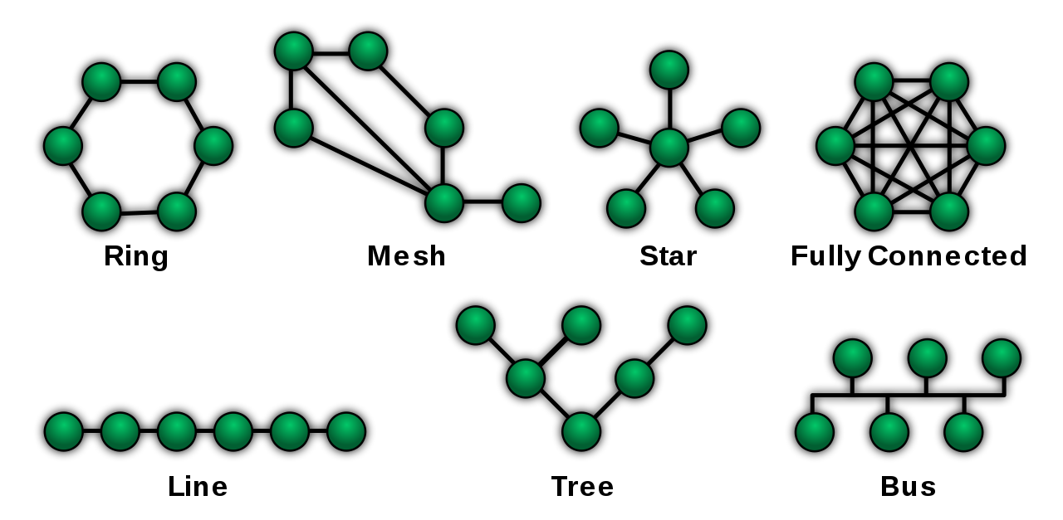
Network Topology

Slide 2
Network topology
Cost: For a network to be cost effective ,one would try to minimise installation cost. This may be achieved by minimizing distance involved.
Flexibility: Due to arrangement of furniture, internal walls etc. in offices is often a factor affecting topology.
Reliability: Failures can occur anywhere in a network. Appropriate topology can help in diagnosing errors faster and reduce time lost.

Slide 3
Point to point link
A point-to-point link-based system provides dedicated links between two devices. For example, a wired system that connects two computers together can be thought of as a point-to-point link. This is in contrast to a broadcast system where one system connects multiple other devices. A good example of a point-to-point system is a telephone call where only two people are connected and communicating.

Slide 4
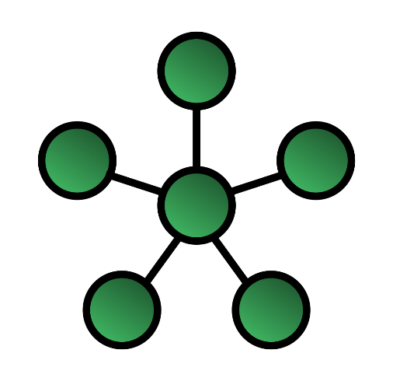
Star Topology
In star topology, all the devices are connected to a single hub through a cable. This hub is the central node and all other nodes are connected to the central node. The hub can be passive in nature i.e., not an intelligent hub such as broadcasting devices, at the same time the hub can be intelligent known as an active hub. Active hubs have repeaters in them. Coaxial cables or RJ-45 cables are used to connect the computers. In Star Topology, many popular Ethernet LAN protocols are used as CD(Collision Detection), CSMA (Carrier Sense Multiple Access), etc.

Slide 5
Star Topology
Advantages
Disadvantages
If N devices are connected to each other in a star topology, then the number of cables required to connect them is N. So, it is easy to set up.
Each device requires only 1 port i.e. to connect to the hub, therefore the total number of ports required is N.
It is Robust. If one link fails only that link will affect and not other than that.
Easy to fault identification and fault isolation.
Star topology is cost-effective as it uses inexpensive coaxial cable.
If the concentrator (hub) on which the whole topology relies fails, the whole system will crash down.
The cost of installation is high.
Performance is based on the single concentrator i.e. hub.

Slide 6
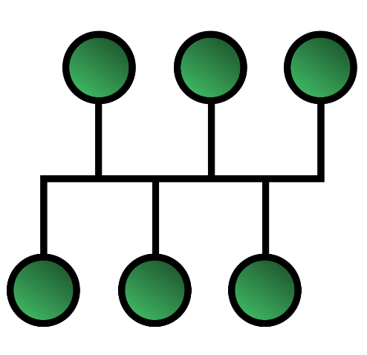
Bus Topology
Bus topology is a network type in which every computer and network device is connected to a single cable. It is bi-directional. It is a multi-point connection and a non-robust topology because if the backbone fails the topology crashes. In Bus Topology, various MAC (Media Access Control) protocols are followed by LAN Ethernet connections like TDMA, Pure Aloha, CDMA, Slotted Aloha, etc.

Slide 7
Bus Topology
Advantages
Disadvantages
If N devices are connected to each other in a bus topology, then the number of cables required to connect them is 1, known as backbone cable, and N drop lines are required.
Coaxial or twisted pair cables are mainly used in bus-based networks that support up to 10 Mbps.
The cost of the cable is less compared to other topologies, but it is used to build small networks.
Bus topology is familiar technology as installation and troubleshooting techniques are well known.
A bus topology is quite simpler, but still, it requires a lot of cabling.
If the common cable fails, then the whole system will crash down.
If the network traffic is heavy, it increases collisions in the network. To avoid this, various protocols are used in the MAC layer known as Pure Aloha, Slotted Aloha, CSMA/CD, etc.
Adding new devices to the network would slow down networks.
Security is very low.

Slide 8
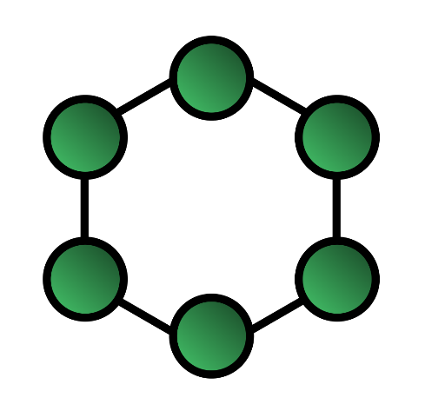
Ring Topology
In this topology, it forms a ring connecting devices with exactly two neighboring devices. A number of repeaters are used for Ring topology with a large number of nodes, because if someone wants to send some data to the last node in the ring topology with 100 nodes, then the data will have to pass through 99 nodes to reach the 100th node. Hence to prevent data loss repeaters are used in the network.
The data flows in one direction, i.e.., it is unidirectional, but it can be made bidirectional by having 2 connections between each Network Node, it is called Dual Ring Topology. In-Ring Topology, the Token Ring Passing protocol is used by the workstations to transmit the data.

Slide 9
Ring Topology
Advantages
Disadvantages
The data transmission is high-speed.
The possibility of collision is minimum in this type of topology.
Cheap to install and expand.
It is less costly than a star topology.
The failure of a single node in the network can cause the entire network to fail.
Troubleshooting is difficult in this topology.
The addition of stations in between or the removal of stations can disturb the whole topology.
Less secure.

Slide 10
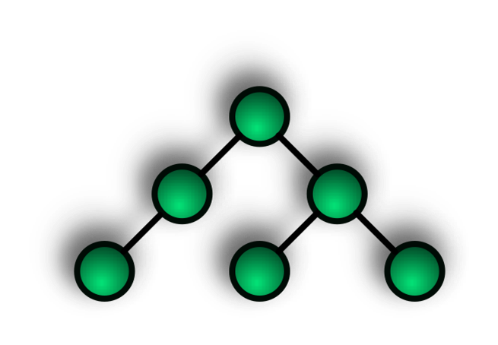
Tree Topology
This topology is the variation of the Star topology. This topology has a hierarchical flow of data. In Tree Topology, protocols like DHCP and SAC (Standard Automatic Configuration ) are used. In this, the various secondary hubs are connected to the central hub which contains the repeater. This data flow from top to bottom i.e. from the central hub to the secondary and then to the devices or from bottom to top i.e. devices to the secondary hub and then to the central hub. It is a multi-point connection and a non-robust topology because if the backbone fails the topology crashes.

Slide 11
Tree Topology
Advantages
Disadvantages
It allows more devices to be attached to a single central hub thus it decreases the distance that is traveled by the signal to come to the devices.
It allows the network to get isolated and also prioritize from different computers.
We can add new devices to the existing network.
Error detection and error correction are very easy in a tree topology.
If the central hub gets fails the entire system fails.
The cost is high because of the cabling.
If new devices are added, it becomes difficult to reconfigure.

Slide 12
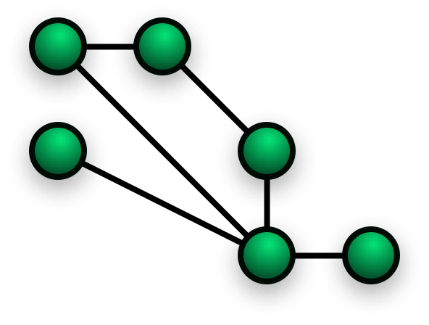
Mesh Topology
In a mesh topology, every device is connected to another device via a particular channel. In Mesh Topology, the protocols used are AHCP (Ad Hoc Configuration Protocols), DHCP (Dynamic Host Configuration Protocol), etc.
Suppose, the N number of devices are connected with each other in a mesh topology, the total number of ports that are required by each device is N-1. In Figure 1, there are 5 devices connected to each other, hence the total number of ports required by each device is 4. The total number of ports required=N*(N-1).
Suppose, N number of devices are connected with each other in a mesh topology, then the total number of dedicated links required to connect them is NC2 i.e. N(N-1)/2. In Figure 1, there are 5 devices connected to each other, hence the total number of links required is 5*4/2 = 10.

Slide 13
Mesh Topology
Advantages
Disadvantages
Communication is very fast between the nodes.
It is robust.
The fault is diagnosed easily. Data is reliable because data is transferred among the devices through dedicated channels or links.
Provides security and privacy.
Installation and configuration are difficult.
The cost of cables is high as bulk wiring is required, hence suitable for less number of devices.
The cost of maintenance is high.

